Slide 1

Diapositiva de recursos humanos 1
House Prices
Eastern Europe
Timeline analysis: 2005 - 2018

Slide 2
Diapositiva de recursos humanos 2
Agenda
Objective and background.
Procedure of analysis.
Correlation between factors.
Descriptive analysis.
Takeaways.

Slide 3
Diapositiva de recursos humanos 9
Determinants of house prices in Eastern Europe
Objective: To analyze house prices behavior along the years (2005 – 2018) and the relationship with different factors.
Poland
Latvia
Background:
Five OECD countries:
Bulgaria
Hungary
Latvia
Lithuania
Poland
It also incorporates economic and demographic factors:
Interest rates
GDP Per capita
Employment
Loans
Population
Bulgaria
Lithuania
Hungary

Slide 4
Diapositiva de recursos humanos 4,
Procedure of analysis
Correlation analysis
Analysis of correlation between factors
Descriptive analysis
Data processing
and merging
Visualization of the house prices vs the different economic and demographic factors individually
Data cleaning, dataset homologation and merging
Data
Collection
Takeaways
Sources: EUROSTAT, OECD

Slide 5
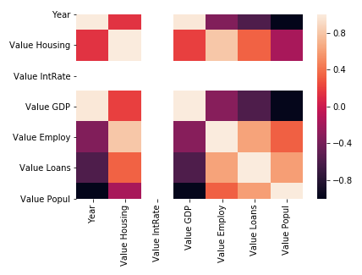
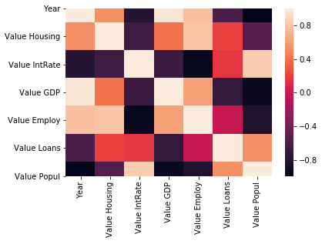
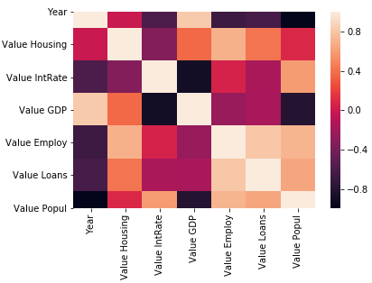
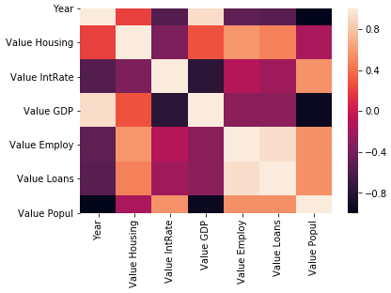
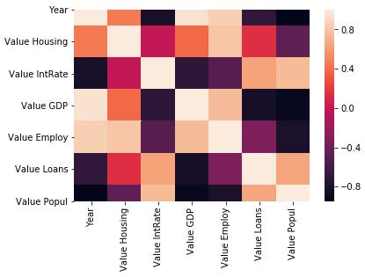
Diapositiva de recursos humanos 8
Correlation between factors
Bulgaria
Hungary
Latvia
Lithuania
Poland

Slide 6
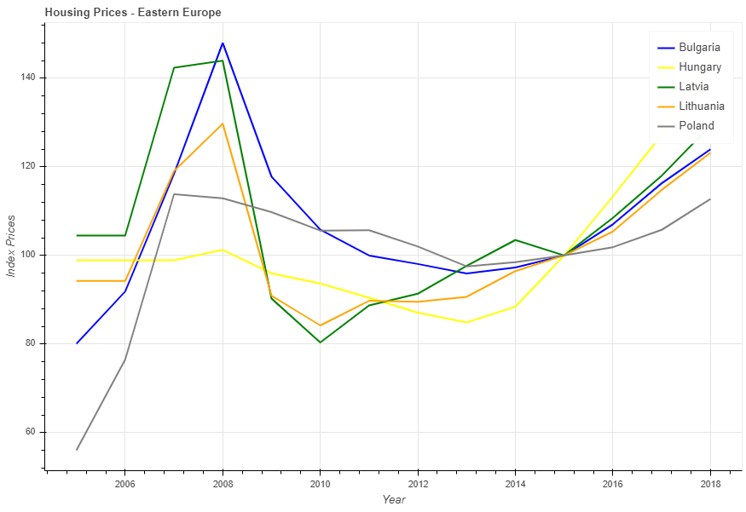
Diapositiva de recursos humanos 8
Descriptive analysis
Trend of prices through the years

Slide 7
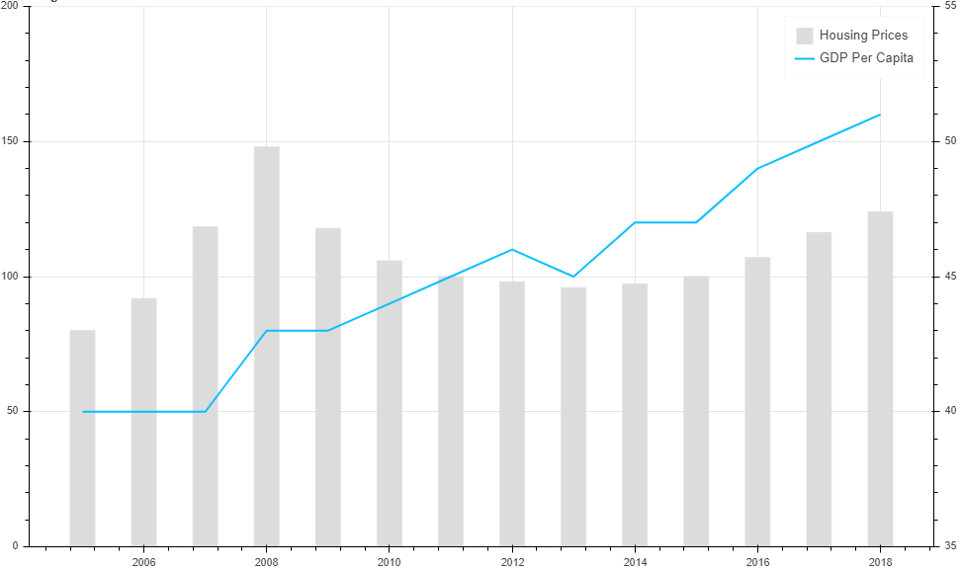
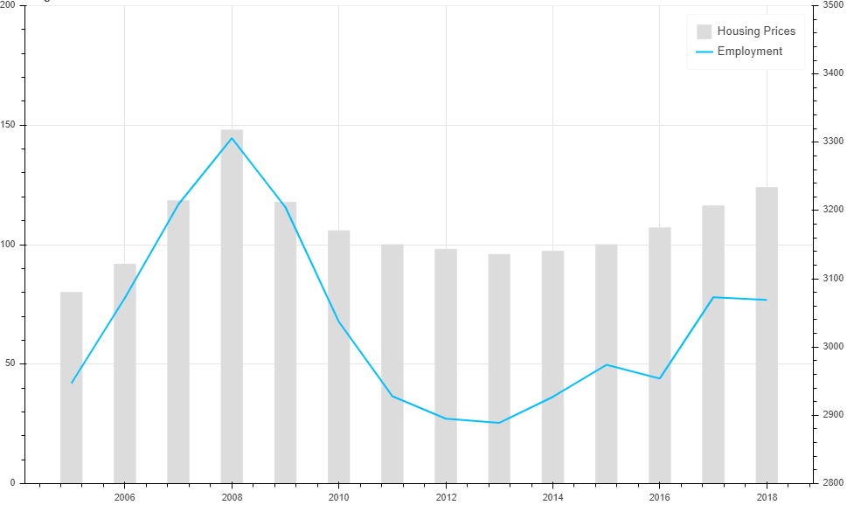
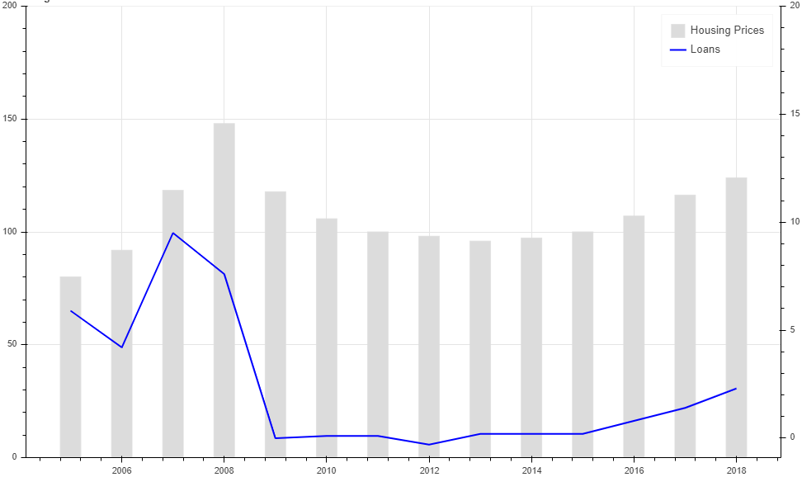
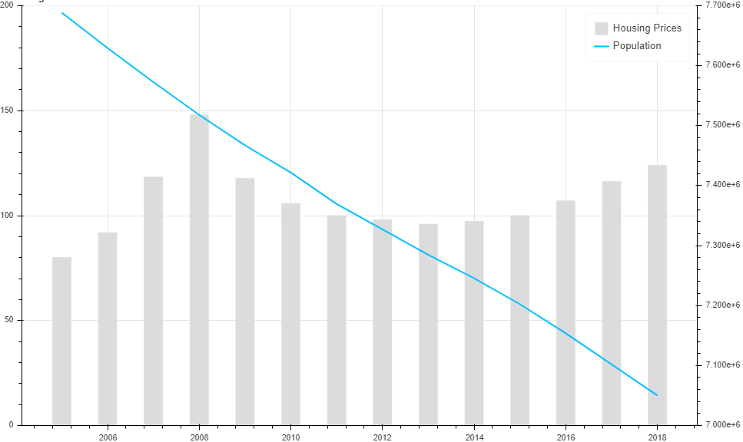
Diapositiva de recursos humanos 8
Descriptive analysis - Bulgaria
GDP
Employment
Loans
Population

Slide 8
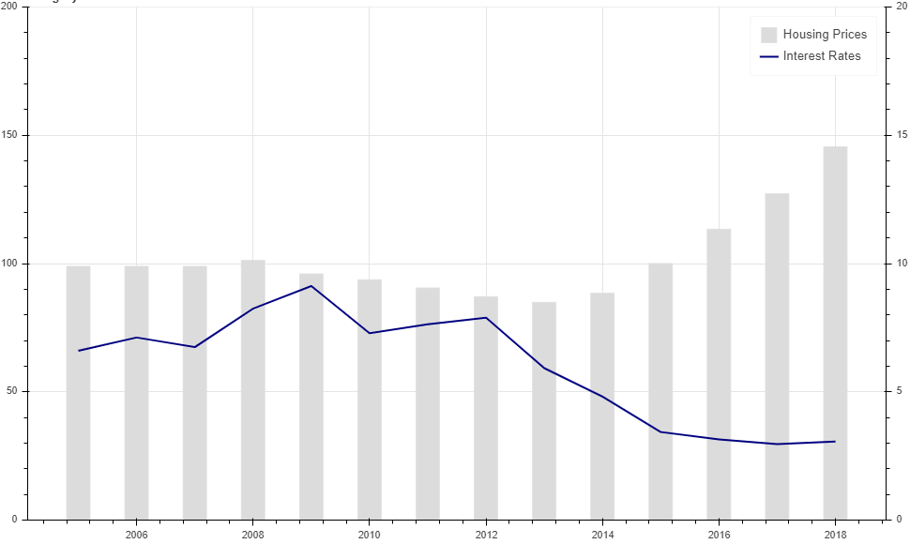
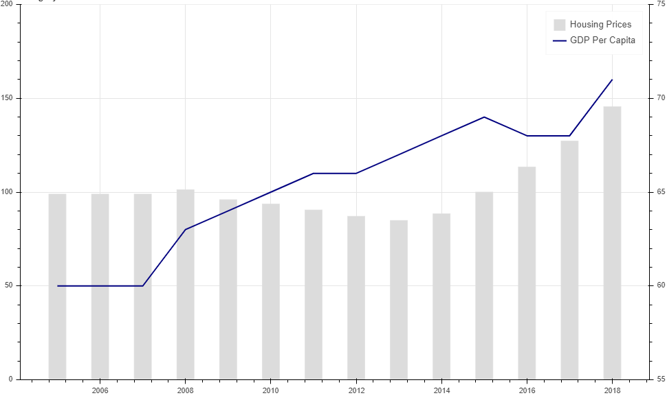
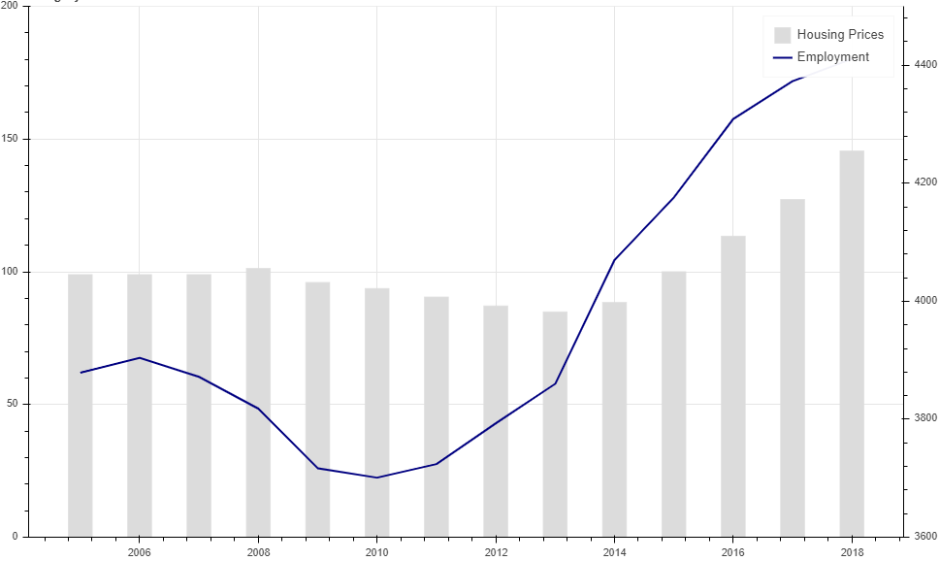
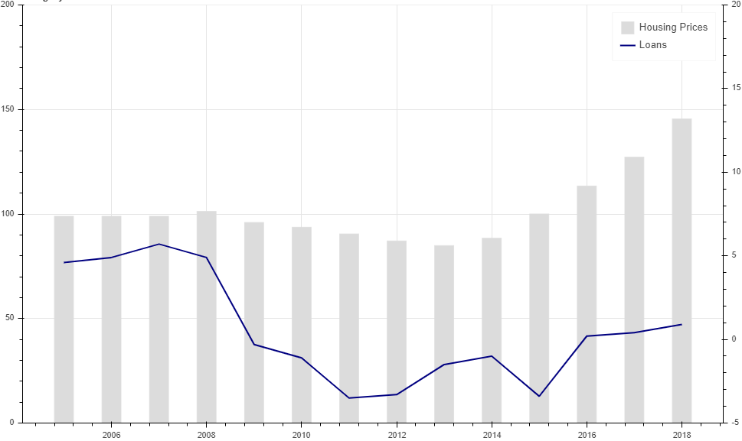
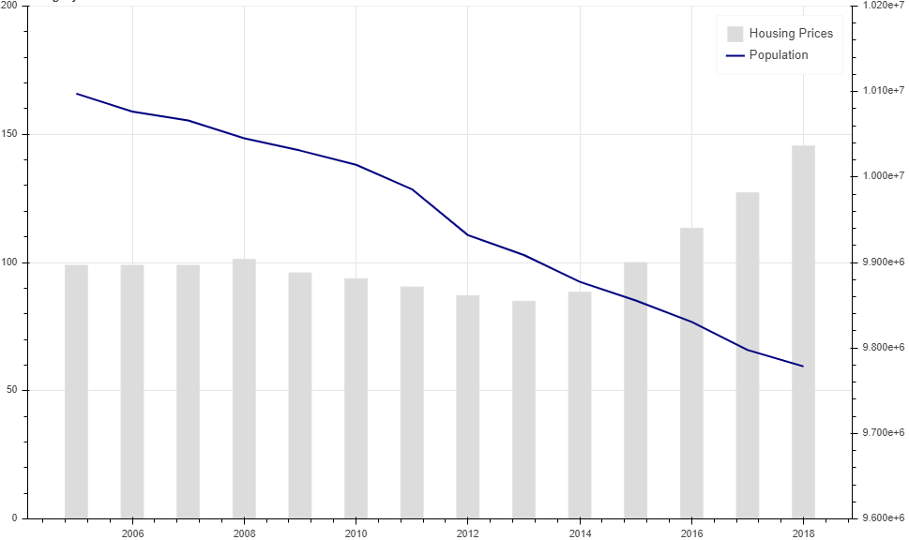
Diapositiva de recursos humanos 8
Descriptive analysis - Hungary
Interest rates
GDP
Employment
Loans
Population

Slide 9
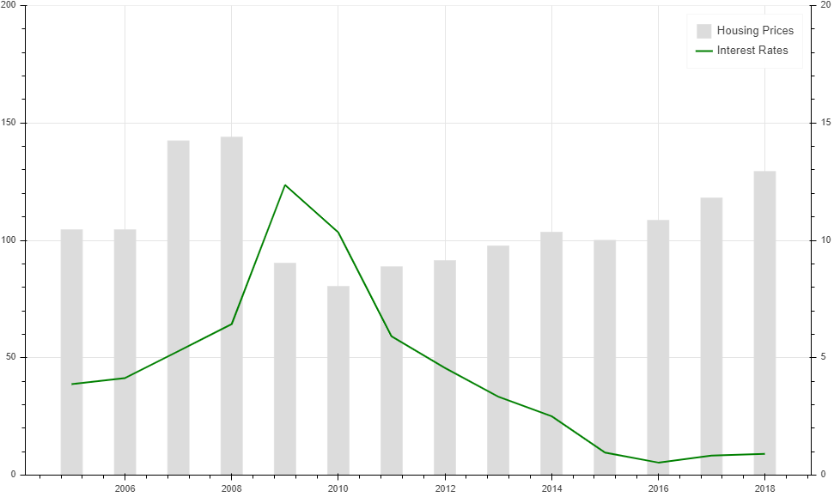
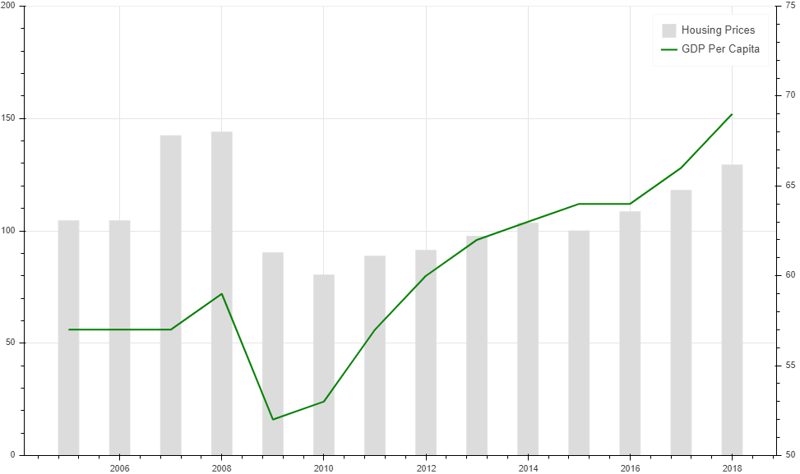
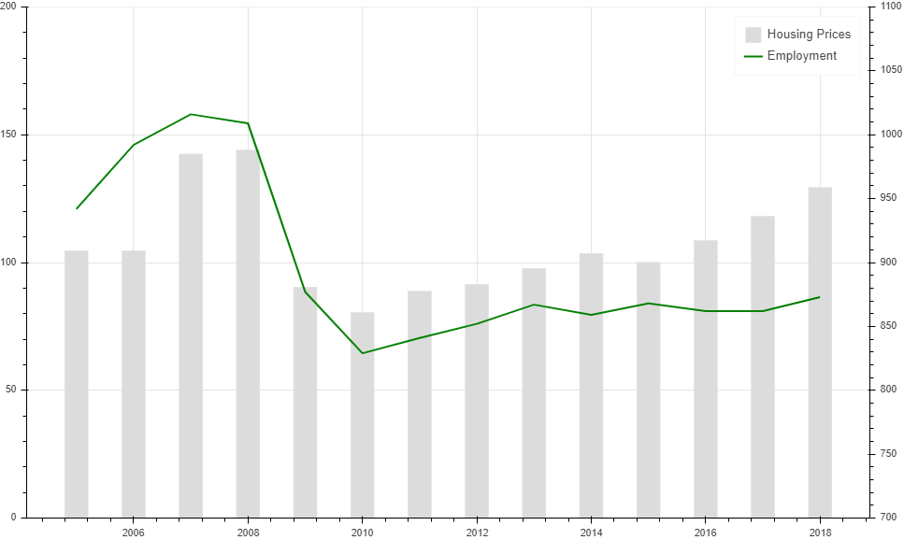
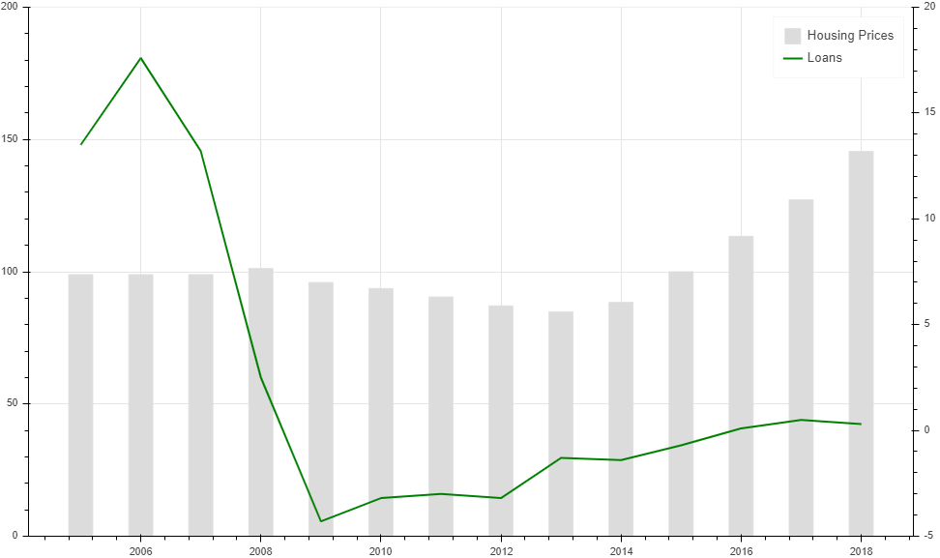
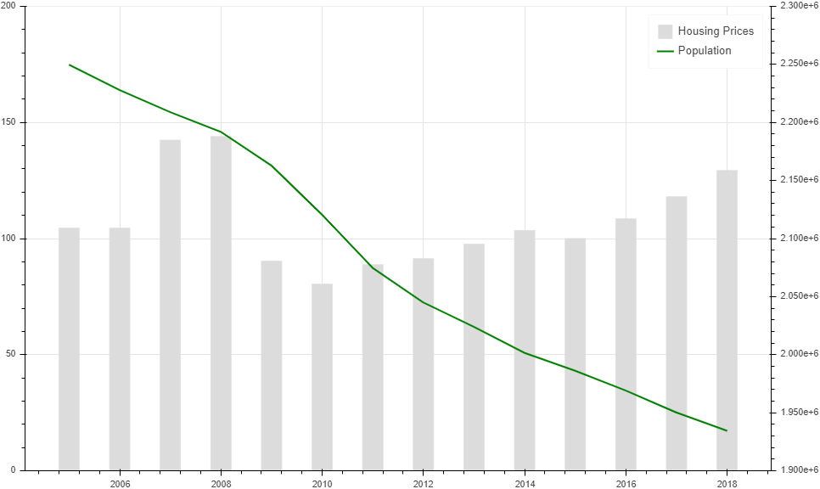
Diapositiva de recursos humanos 8
Descriptive analysis - Latvia
Interest rates
GDP
Employment
Loans
Population

Slide 10
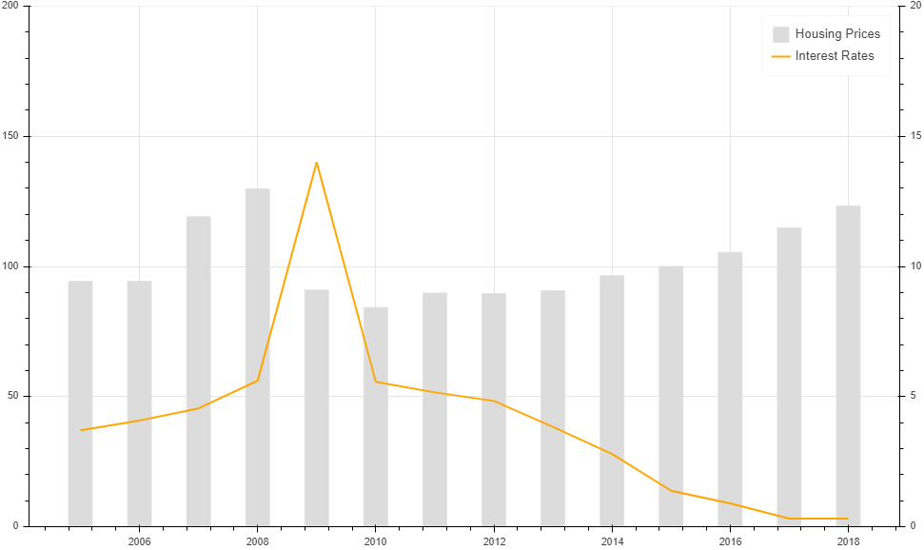
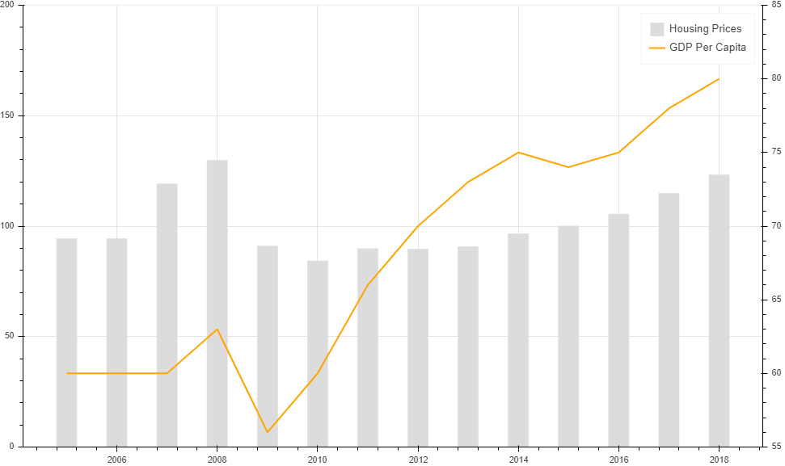
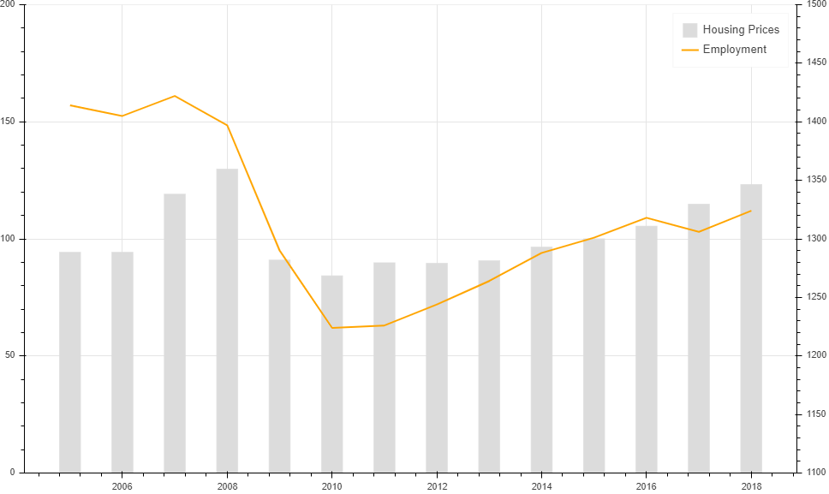
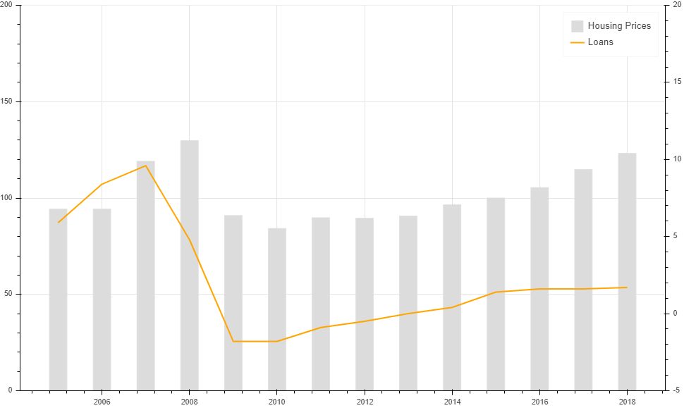
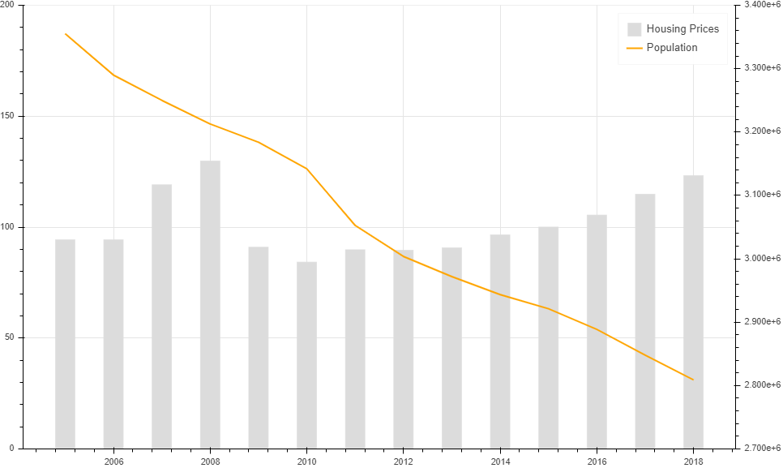
Diapositiva de recursos humanos 8
Descriptive analysis - Lithuania
Interest rates
GDP
Employment
Loans
Population

Slide 11
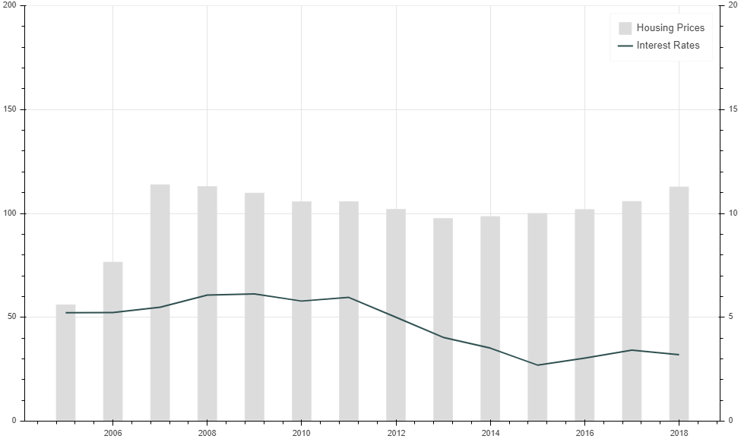
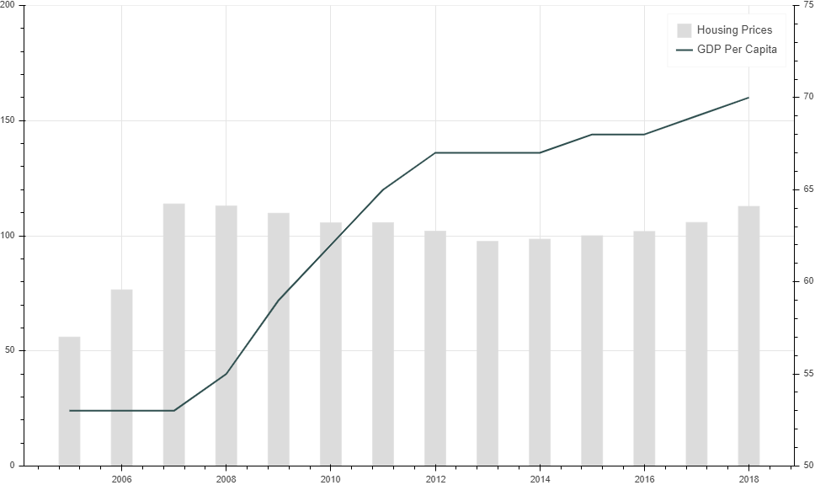
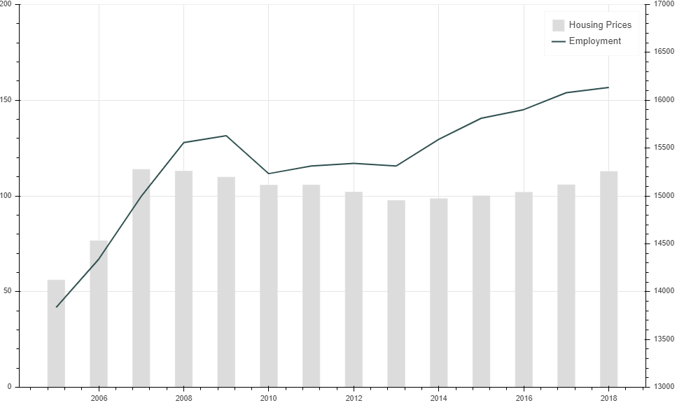
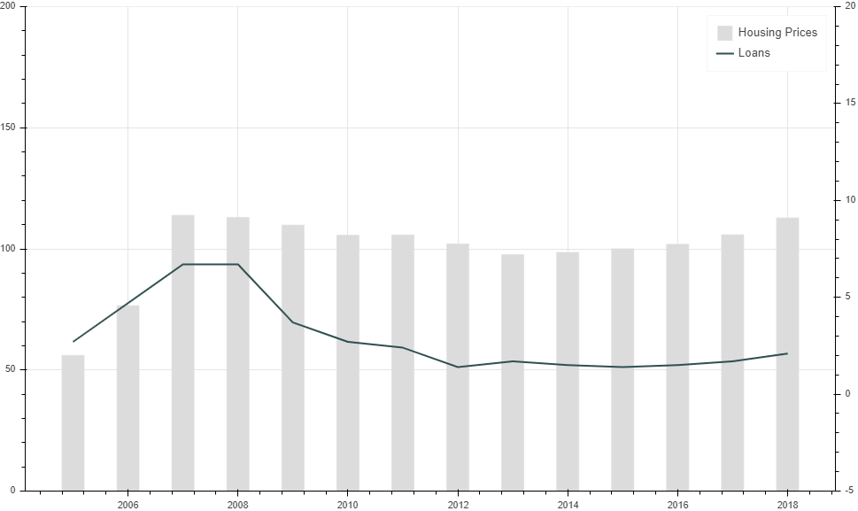
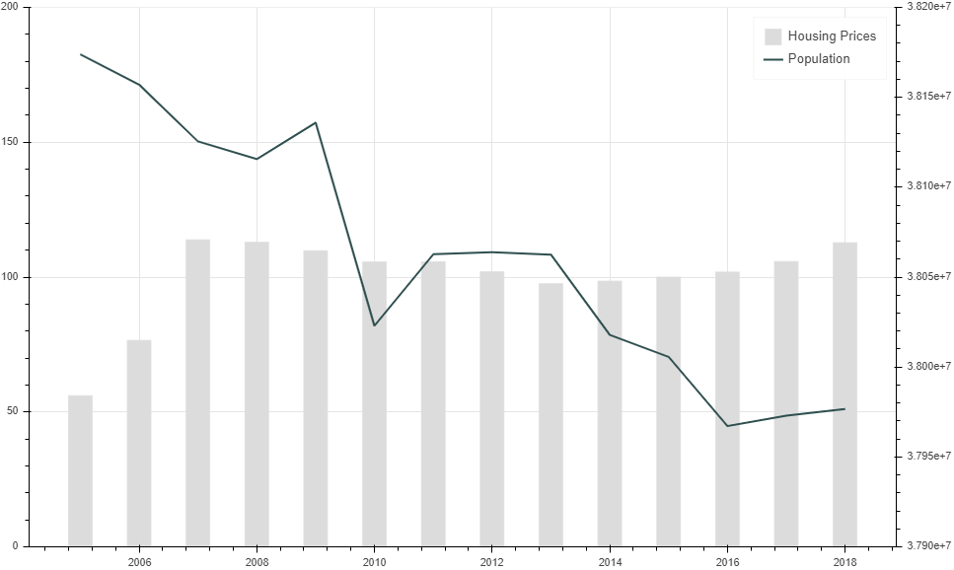
Diapositiva de recursos humanos 8
Descriptive analysis - Poland
Interest rates
GDP
Employment
Loans
Population

Slide 12
Diapositiva de recursos humanos 6
Takeaways
Bulgaria and Latvia are the countries with the highest price volatility; even presenting important peaks in 2008. Just prior to the collapse of the real estate bubble in the United States.
The economic factors that most impact the determination of house prices are:
Employment
Loans
GDP
The financial crisis of 2008 was a watershed in the drop of house prices. However, interestingly , this event had no major repercussions in the markets of Hungary and Poland.
As of 2009, the market begins to recover and, in some cases, (Hungary and Poland), prices pick up again.

Slide 13
Diapositiva de recursos humanos 10
Thank you!

